Slide 1
games 4 u add fun to your life
Team members:
Svs Nagarjuna
Svs Meenakshi
P Hema latha
Project Link :
https://nagarjuna-singarapu.github.io/Gaming_project/game.html

Slide 2
Welcome to games 4 u……
During the pandemic we all know that no one is allowed outside , we all stayed at home.
At home we felt bored , depressed a lot and we don’t know what to do ,so we thought that we want to bring some fun and joy at being home only.
So, we brought games 4 u …which brings a lot of indoor games for you
We include all type of games for(kids , young, family , old people)

Slide 3
Indoor games
During covid time indoor games got more importance for kids
Mainly Indoor games help for creating thinking, improves brain power
and they can develop relationship with others
It reduces Anxiety , stress, and create happiness and maintain focus
All people can play indoor games without help of internet

Slide 4
WHO CAN PLAY?
KIDS
YOUNG PEOPLE
OLD PEOPLE
FAMILY

Slide 5
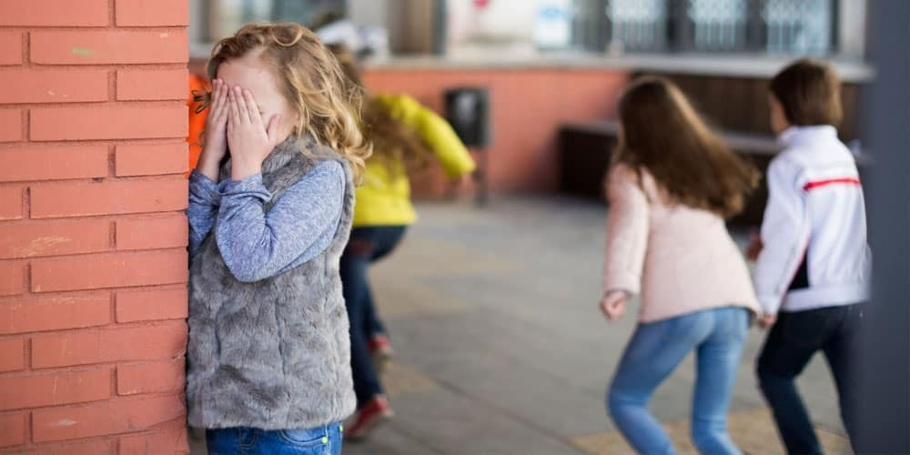
kids
Indoor games for kids will helpful for learning new things, creative mind, and physical Activities
Some of the indoor games for kids are:
.hide and seek
.bubble game
.balancing beam
Ex: hide and seek

Slide 6

Young people
Young people gets more energy , they are capable of playing any games.
Some of the indoor games for young people are:
.truth or dare
.guessing movie
.ludo
Ex : truth or dare

Slide 7
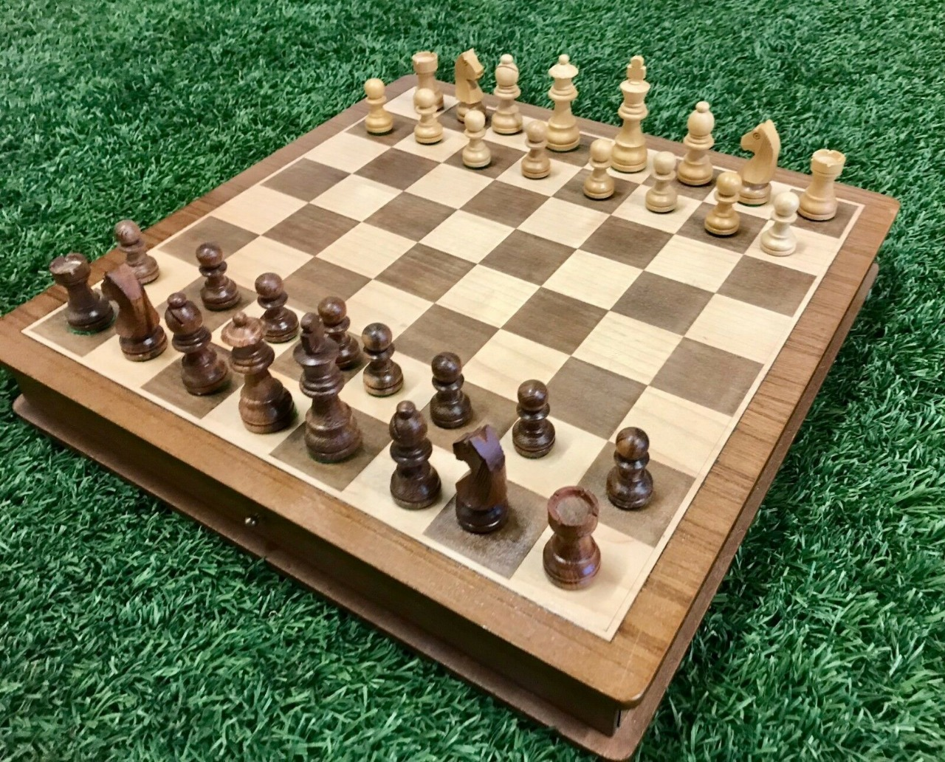
Old people
For the old people they love to play games more ,because they don’t want to feel alone .
So they show more interest in indoor playing ,it helps in keeping energy and fun
Some of the indoor games are:
Chess , cards , puzzles
Ex : chess

Slide 8
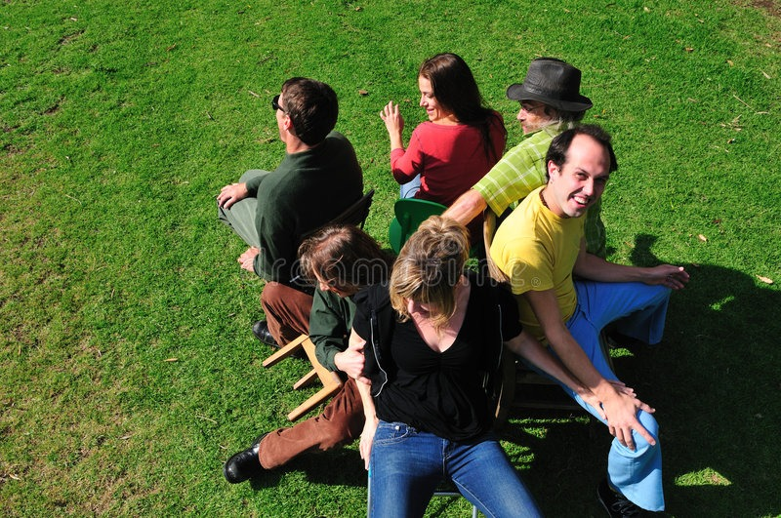
family
Family means a group people come together and play .It will be a lot of fun and joy
Indoor games for family will be more enjoyable
Some of the indoor games are:
Carroms
Musical chair
Tambola
Ex: musical chair

Slide 9



